Slide 1
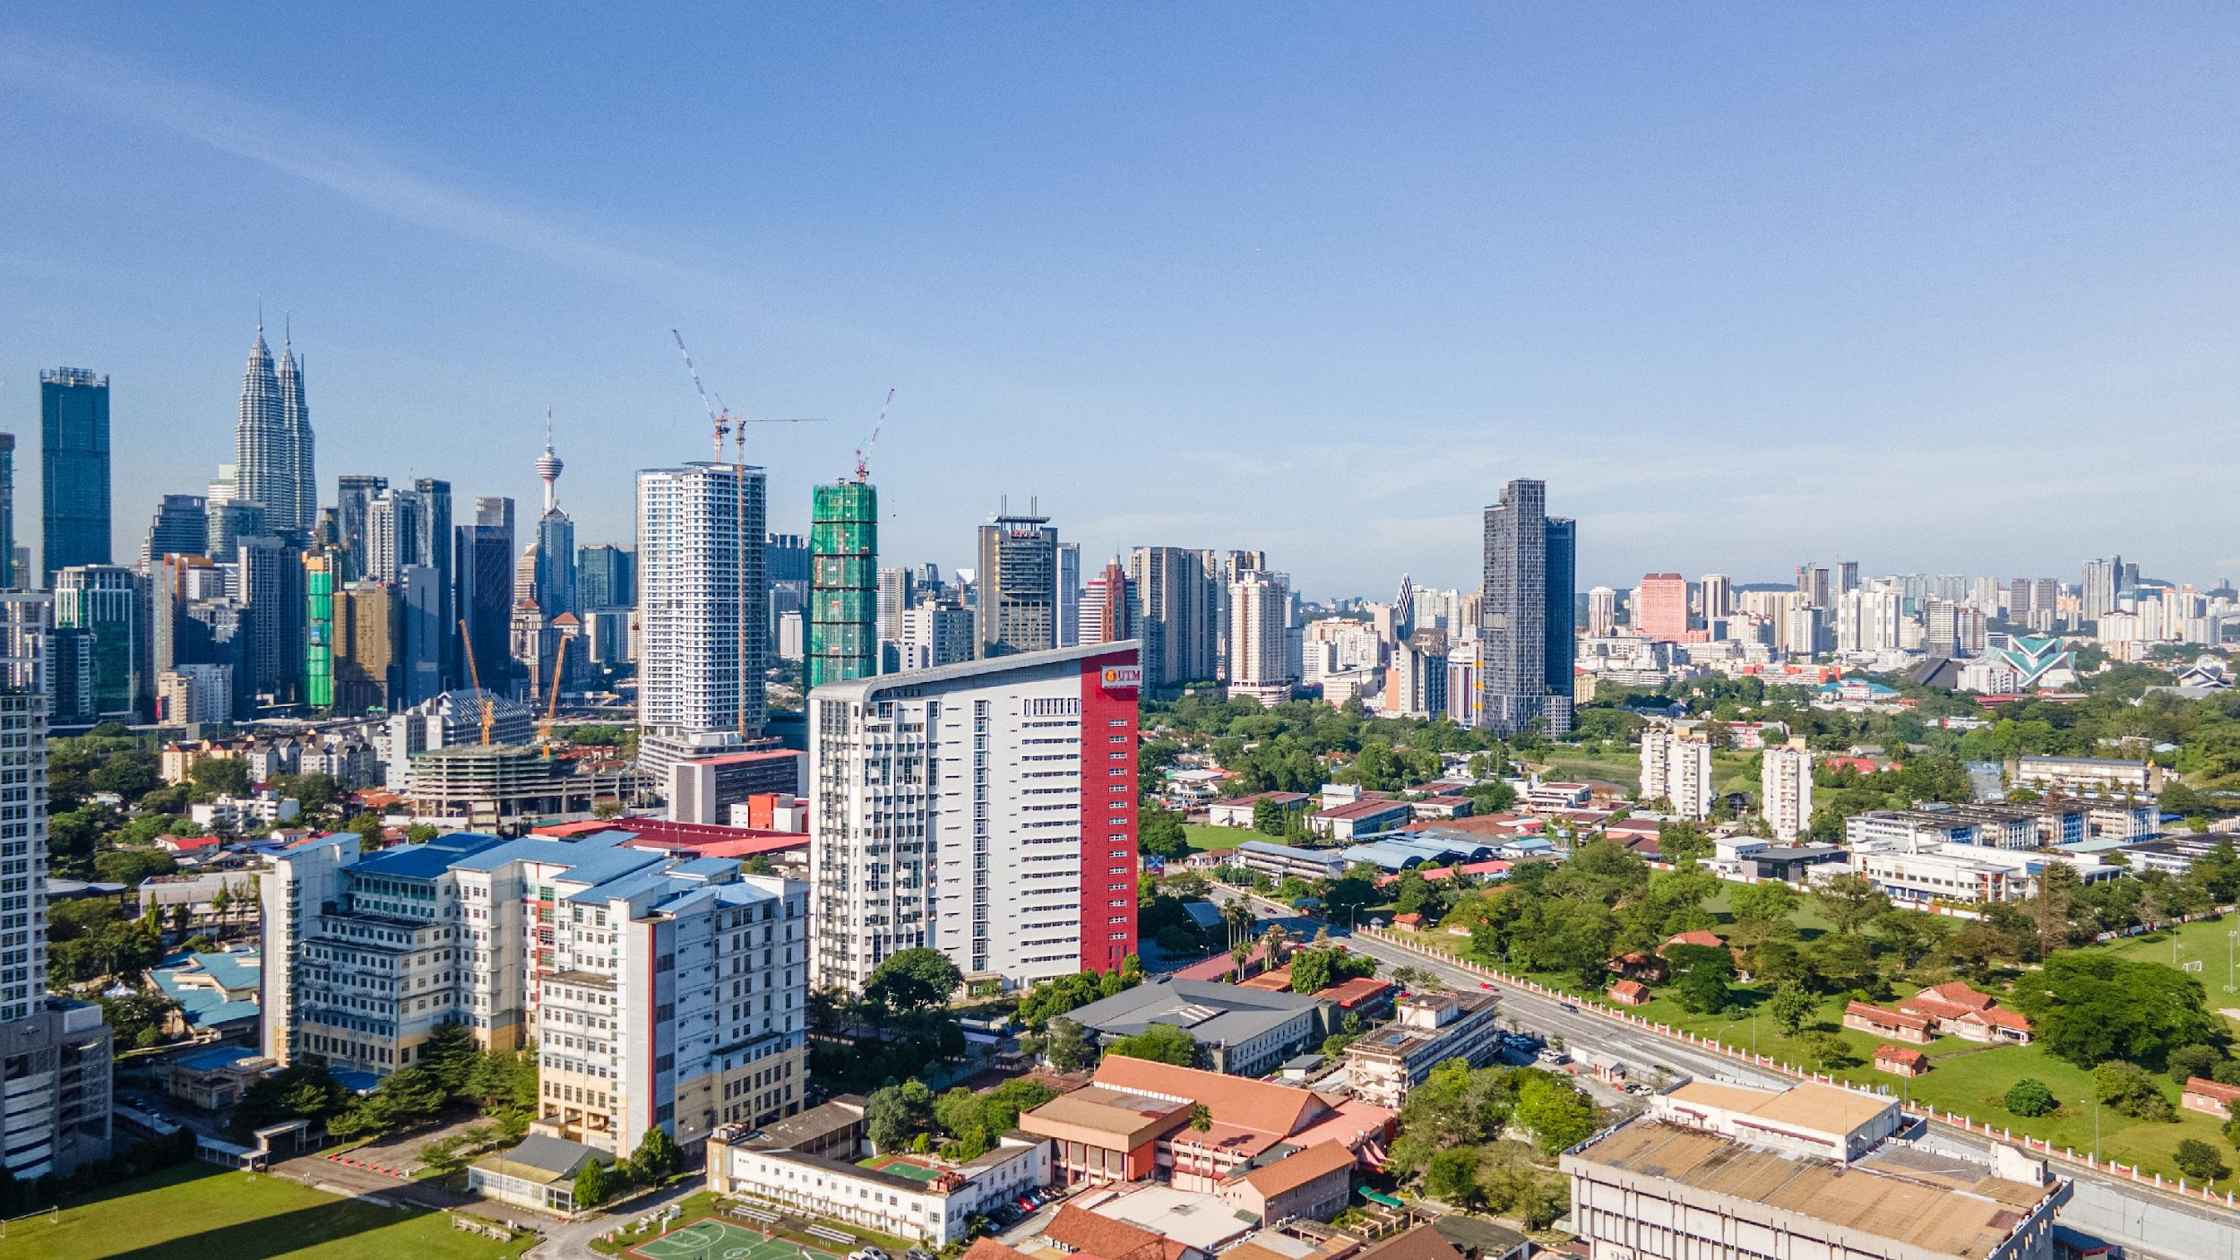

Seci1143
Probability & statistical data analysis
CHAPTER 3
Descriptive Statistics
Innovating Sustainable Solutions
Notes:
prepared by Razana Alwee / edited by Suhaila Mohamad Yusuf

Slide 2
Measures
of
Central Tendency

Slide 3
Measurement of Central Tendency
A measure of central tendency of a distribution is a numerical value that describes the central position of the data or how the data tend to build up in the center.
Measurements:
Mean
Mode
Median

Slide 4
Mean
Mean is the sum of the observations divided by the number of observations.
It is the most common measure of central tendency,
Sample mean:
Population mean:

Slide 5
Example
Data: 13, 18, 13, 14, 13, 16, 14, 21, 13
The mean is 15
Calculation:
(13 + 18 + 13 + 14 + 13 + 16 + 14 + 21 + 13) ÷ 9 = 15

Slide 6
The mean is unique for every set of data.
Meaningful for interval and ratio data.
Can be affected by outliers – rare observations that are radically different from the rest.
Example: 3, 4, 6, 4, 7, 3, 6, 5, 1500
Mean: 170.89

Slide 7
Mean of Grouped Data
The formula for the mean of grouped data,
where,
f_{i} : frequency in a class or frequency of an observed value.
X_{i} : class midpoint or an observed value.
n : number of classes or number of observed values.

Slide 8


Example
Find the mean value for the following data:
Number of children (X_{i}) | 1 | 2 | 3 | 4 | 5 | 6 | 7
Frequency (f_{i}) | 5 | 12 | 8 | 3 | 0 | 0 | 1
Solution:
Σ f_{i}X_{i} = 5(1) + 12(2) + 8(3) + 3(4) + 0(5)+ 0(6) + 1(7) = 72

Slide 9
Example
Find the mean value for the following data:
Class interval | Frequency
40.5 – 45.5 45.5 – 50.5 50.5 – 55.5 55.5 – 60.5 60.5 – 65.5 | 7 10 15 12 6
Total | 50

Slide 10


Example
Class interval | Midpoint | Frequency | f_{i}X_{i}
40.5 – 45.5 45.5 – 50.5 50.5 – 55.5 55.5 – 60.5 60.5 – 65.5 | (40.5 + 45.5) ÷ 2 = 43 48 53 58 63 | 7 10 15 12 6 | 43 x 7 = 301 480 795 696 378
Total |  | 50 | 2650

Slide 11
Median
The median is the middle value when the data are arranged from smallest to largest.
To find the median, your numbers must be listed in an order, so you may have to rewrite your list first.
For an odd number of observations, the formula for the place to find the median is
([the number of data points] + 1) ÷ 2

Slide 12
Example
Data: 13, 18, 13, 14, 13, 16, 14, 21, 13
Arrange in order: 13, 13, 13, 13, 14, 14, 16, 18, 21
There are nine numbers in the list, so, the middle one will be the (9 + 1) ÷ 2 = 10 ÷ 2 = 5th number.
So, the median is 14.

Slide 13
For an even number of observations, the median is the mean of the two middle numbers.
Example:
2, 3, 3, 5, 6, 7, 8, 9
(5 + 6) ÷ 2 = 5.5 (median)

Slide 14
The median is meaningful for ratio, interval, and ordinal data.
The median is not affected by outliers.
Example: 3, 4, 6, 4, 7, 3, 6, 5, 1500
(sort) ↓
3, 3, 4, 4, 5, 6, 6, 7, 1500
Median: 5

Slide 15
Median of Grouped Data
The median for the grouped data is given by
where,
(Median class is the first class with the value of cumulative frequency equal at least N/2)
L : lower class limit of median class, N : total number of observations,
cf_{p} : cumulative frequency of the class preceding the median class, f_{med} : frequency of the median class,
W : median class size.

Slide 16
Example
N÷2 = 40÷2=20
.: median class = 50.5 - 55.5
Class interval | Frequency | Cumulative frequency
40.5 – 45.5 45.5 – 50.5 50.5 – 55.5 55.5 – 60.5 60.5 – 65.5 | 7 10 15 2 6 | 7 17 32 34 40
Total | 40
(55.5-50.5)
= 51.5

Slide 17
Mode
The mode is the value that occurs most often.
If no number is repeated, then there is no mode for the list.

Slide 18
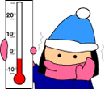
Example
Case study: On a cold winter day in January, the temperature for 9 North American cities is recorded in Fahrenheit as follows:
-8, 0, -3, 4, 12, 0, 5, -1, 0
What is the mode of these temperatures?
Solution:
Ordering the data from least to greatest, we get:
-8, -3, -1, 0, 0, 0, 4, 5, 12
The mode of these temperatures is 0 Fahrenheit.

Slide 19

Example
Case study: A marathon race was completed by 5 participants. The time taken by each participant is recorded as follows:
2.7 hr, 8.3 hr, 3.5 hr, 5.1 hr, 4.9 hr
What is the mode of these times given in hours?
Solution:
Ordering the data from least to greatest, we get:
2.7, 3.5, 4.9, 5.1, 8.3
Since each value occurs only once in the data set, there is no mode for this data set.

Slide 20

Example
Case study: In a crash test, 11 cars were tested to determine what impact speed was required to obtain minimal bumper damage. The collected data as shown below:
24, 15, 18, 20, 18, 22, 24, 26, 18, 26, 24
Find the mode of the speeds given in miles per hour.
Solution:
Ordering the data from least to greatest, we get:
15, 18, 18, 18, 20, 22, 24, 24, 24, 26, 26
Since both 18 and 24 occur three times, the modes are 18 and 24 miles per hour. This data set is bimodal.

Slide 21
Mode of Grouped Data
The first step towards finding the mode of the grouped data is to locate the class interval with the maximum frequency.
The class interval corresponding to the maximum frequency is called the modal class.

Slide 22
The mode of grouped data is calculated using the formula
Mode = l + h × [(f₁ – f₀) ÷ (2f₁ – f₀ – f₂)]
where,
l : lower class limit of the modal class
h : class size if all class intervals have the same class size
f₁ : frequency of the modal class
f₀ : frequency of the class preceding or just before the
modal class
f₂ : frequency of the class succeeding or just after the
modal class

Slide 23
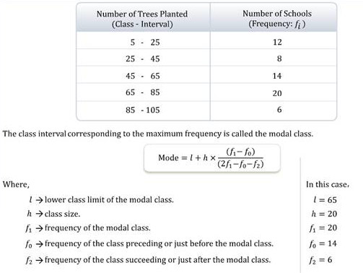

Example
h=85-65=20

Slide 24
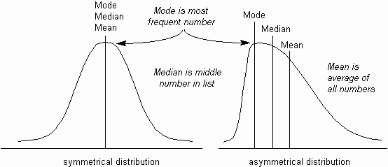



Slide 25
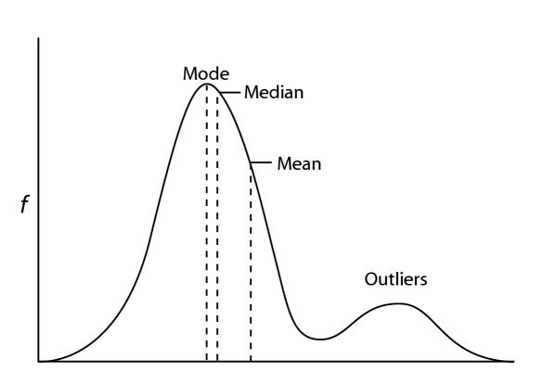
Example

Slide 26
Exercise #1
The owner of a shoe shop recorded the sizes of the feet of all the customers who bought shoes in his shop in one morning. These sizes are listed below:
8, 7, 4, 5, 9, 13, 10, 8, 8, 7, 6, 5, 3, 11,10, 8, 5, 4, 8, 6
What is the mean of these values?
What is the median of these values?
What is the mode of these values?
Notes:
mean: 7.25
median: 7.5
mode: 8
data: 3 4 4 5 5 5 6 6 7 7 8 8 8 8 8 9 10 10 11 13

Slide 27
Exercise #2
The table below gives the number of accidents each year at a particular road junction:
(a) Calculate the mean, median and mode for the values above.
(b) A road safety group want the council to do some improvement to make this junction safer. Which measure will they use to argue for this?
(c) The council don't want to spend money on the road junction. Which measure will they use to argue that safety work is not necessary?
2001 | 2002 | 2003 | 2004 | 2005 | 2006 | 2007 | 2008
4 | 5 | 4 | 2 | 10 | 5 | 3 | 5
Notes:
X: 2001 2002 2003 2004 2005 2006 2007 2008
F: 4 5 4 2 10 5 3 5
(a)
CF: 4 9 13 15 25 30 33 38
XF: 8004 10010 8012 4008 20050 10030 6021 10040
sum(XF): 76175
mean: 2004.6053
median: 2005.4000
mode: 2005.6154
(b) mode and mean
(c) median and mode
Mean = (4+5+4+2+10+5+3+5​)/8 = 38/8​ = 4.75, 2,3,4,4,5,5,5,10 Median = (4+5)/2 = 4.5, Mode = 5
(b) Mean or Maximum (10) to argue for improvements.
(c) Median or Mode to argue against spending.

Slide 28
Exercise #3
You grew fifty baby carrots using special soil. You dig them up and measure their lengths (to the nearest mm) and group the results:
Find the
(a) mean (b) median (c) mode
Length (mm) | Frequency
149.5 – 154.5 | 5
154.5 – 159.5 | 2
159.5 – 164.5 | 6
164.5 – 169.5 | 8
169.5 – 174.5 | 9
174.5 – 179.5 | 11
179.5 – 184.5 | 6
184.5 – 189.5 | 3
Notes:
Total number of carrots (N): 5+2+6+8+9+11+6+3=505+2+6+8+9+11+6+3=50
Mean=8,530/50​=170.6 mm
median class: 169.5 – 174.5
L=169.5
F=5+2+6+8=21
fmed=9
w=5
Median=169.5+(25−21​)/9×5=169.5+2.22=171.72 mm
Modal class: Highest frequency = 174.5 – 179.5.
L=174.5
f0​=9 (169.5 – 174.5)
f2​=6 (179.5 – 184.5)
w=5
Mode=174.5+((11−9)/(22−9−6))×5=174.5+((2/7)×5)=174.5+1.43=175.93 mm

Slide 29
Exercise #4
Find the mean, median and mode corresponding to the frequency table of samples of student cars and faculty/staff cars obtained from a college.
Age | Students | Faculty/Staff
0.5 – 3.5 | 23 | 30
3.5– 6.5 | 33 | 47
6.5 – 9.5 | 63 | 36
9.5 – 12.5 | 68 | 30
12.5 – 15.5 | 19 | 8
15.5 – 18.5 | 10 | 0
18.5 – 21.5 | 1 | 0
21.5 – 24.5 | 0 | 1

Slide 30
Data Profiles
Percentile
Quartile

Slide 31
Percentile
In a population or a sample, the P-th percentile is a value such that at least P percent of the values take on this value or less and at least (100-P) percent of the values take on this value or more.

Slide 32
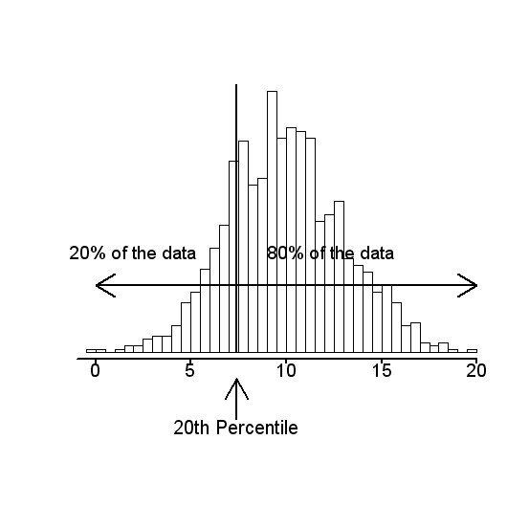


Example
100-20=80%

Slide 33
Sort the data set so measurements are in order from lowest to highest,
Y[1], Y[2], …. , Y[N]
Calculate,
If i is not an integer, round up to the next highest integer k and use Y[k] as the percentile estimate.
If i is an integer, use (Y[i] + Y[i+1]) ÷ 2 as the percentile estimate.

Slide 34


Example
Given set of data:
12, 4, 6, 11, 9,15, 20, 18, 25, 30
Calculate 80th percentile.
Calculate 68th percentile.
Solution (i):
Arrange in order:
4 6 9 11 12 15 18 20 25 30
N = 10, P = 80 ; i = 80 x 10 ÷ 100 = 8
Y[8] = 20, Y[9] = 25, P₈₀ = (20 + 25) ÷ 2 = 22.5
(integer)

Slide 35

Example
Solution (ii): Calculate 68th percentile
N = 10, P = 68
4 6 9 11 12 15 18 20 25 30
i = 68 x 10 ÷ 100 = 6.8, k = 7
Y[7] = 18, P₆₈ = 18
(not integer)

Slide 36
The process of finding the percentile that corresponds to a particular value x is:

Slide 37







Example
Given a set of data as follows:
12 4 6 11 9 15 20 18 25 30
Find the percentile corresponding to the value,
Y[k] = 15
Solution: Arrange the data in order,
4 6 9 11 12 15 18 20 25 30
The value 15 is the 50th percentile.

Slide 38
Quartile
The 1st, 2nd, and 3d quartiles are the 25th, 50th, and 75th percentiles, respectively.

Slide 39
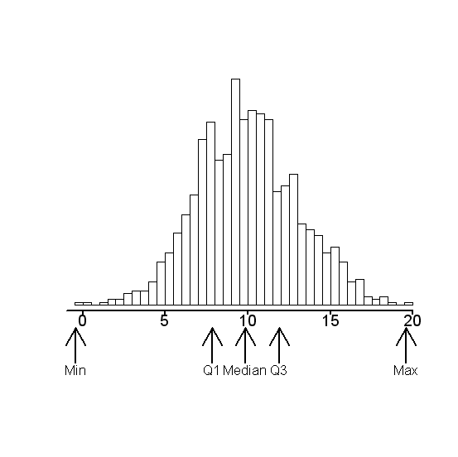
Example
Q1 – 25th percentile
Q2 – 50th percentile (median)
Q3 – 75th percentile

Slide 40
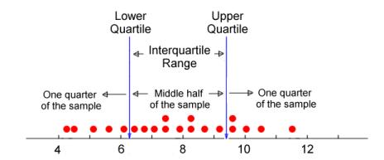
Example
Q1
Q3
Note:
Interquartile Range (IQR) = Q3 – Q1
Lower Limit: Q1 – 1.5✕IQR
Higher Limit: Q3 + 1.5✕IQR

Slide 41
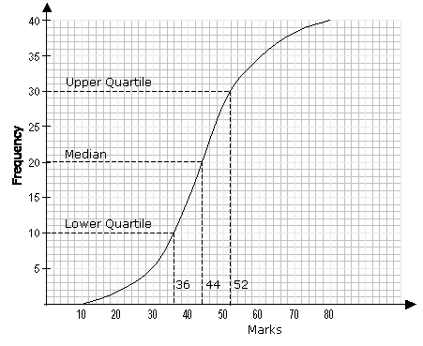
Example

Slide 42
Exercise #5
0.7901 | 0.8044 | 0.8062 | 0.8073 | 0.8079 | 0.8110
0.8126 | 0.8128 | 0.8143 | 0.8150 | 0.8150 | 0.8152
0.8152 | 0.8161 | 0.8161 | 0.8163 | 0.8165 | 0.8170
Use the 18 sorted (left to right) weights of regular can drinks to find the percentile corresponding to the given value.
0.8143
0.8062
Find the indicated percentile and quartile.
P₈₀
Q₃
P₃₃
Q₁
Notes:
(i) 44.44 (ii) 11.11
(i) 0.8161 (ii) 0.8161 (iii) 0.8110 (iv) 0.8079

Slide 43
Measures
of
Dispersion & Shape

Slide 44
Measures of Dispersion
Measures of dispersion measure how spread out a set of data is.
Range, variance, standard deviation

Slide 45
Range
The range is the largest number in a set minus the smallest number.
Example: 13, 18, 13, 14, 13, 16, 14, 21, 13
The largest value in the list is 21,
and the smallest is 13,
so, the range is 21 – 13 = 8.

Slide 46
Variance
A measure of the dispersion of a set of data points around their mean value.
It is a mathematical expectation of the average squared deviations from the mean.
low variance: data points are close to mean (consistent)
high variance: data points are far from mean and each other (inconsistent)

Slide 47
Sample variance:
Population variance:

Slide 48
Standard Deviation
A statistic is used as a measure of the dispersion or variation in a distribution, equal to the square root of the arithmetic mean of the squares of the deviations from the arithmetic mean.
It is the square root of the variance.

Slide 49
Exercise #6
Bailey has been playing golf on the weekends for the past three years. Recently, she started keeping track of her recorded scores. Her scores for June and July at her favorites 9-hole (par 36) golf course are provided below:
45 49 42 56 41 36 34 38 41 45 40 42 41 39 38 40 39 36 41
Find the Range, Variance, and Standard Deviation for the above data.

Slide 50
Measures of Shape
Skewness:
Positive skew: Income distribution (few high earners drag mean > median).
Negative skew: Age at retirement (most retire early, few very late).
Kurtosis:
High kurtosis (Leptokurtic): Stock market crashes (extreme outliers).
Low kurtosis (Platykurtic): Height of adults (most clustered around average).
Notes:
When to Use Them Together
Data Exploration:
Skewness + kurtosis reveal if data is normal (bell-curved).
Example: If skewness ≈ 0 and kurtosis ≈ 3, data is likely normal.
Statistical Testing: Many tests (e.g., ANOVA) assume normality. Skewness/kurtosis help validate this.
Algorithm Selection: Decision trees handle skewed data well; neural networks may need normalized data.

Slide 51
Skewness
Purpose: Measures asymmetry in data. Key Uses:
Identify Data Bias:
Example: Income data is often right-skewed (mean > median). Knowing this helps avoid misinterpreting averages.
Action: Use median instead of mean for skewed data.
Improve Model Accuracy:
Machine learning algorithms (e.g., linear regression) assume symmetric data. Skewed data can bias results.
Action: Apply log transformations to right-skewed data.
Risk Assessment:
In finance, negative skewness indicates higher risk of extreme losses.
Real-World Example:
Insurance Claims: Most claims are small (left-skewed), but a few are huge. Skewness helps price policies correctly.

Slide 52
Kurtosis
Purpose: Measures tail heaviness (outlier risk). Key Uses:
Detect Outliers:
High kurtosis (leptokurtic) means more outliers (e.g., stock market crashes).
Low kurtosis (platykurtic) suggests data is tightly clustered (e.g., heights of adults).
Quality Control:
Manufacturing processes with high kurtosis may produce defective items sporadically.
Financial Modeling:
Portfolio managers check kurtosis to assess crash risk (e.g., Bitcoin returns have high kurtosis).
Real-World Example:
Medical Trials: Drug side-effect data with high kurtosis signals rare but severe reactions.

Slide 53
Skewness
Occurs when a distribution is not symmetrical about its mean.
A distribution is symmetrical when its median, mean, and mode are equal.
A positively skewed (skewed to the right) distribution occurs when the mean exceeds the median.
A negatively skewed (skewed to the left) distribution occurs when the mean is less than the median.

Slide 54
Measuring Skewness
Formula to measure skewness for univariate data x₁, x₂, .., x_{N}:
X = mean
Number of data points
s = standard deviation

Slide 55
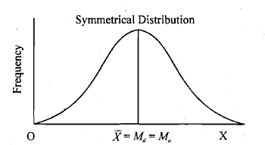
For normal distribution (symmetric distribution):
skewness = 0.
Any symmetric data should have:
Skewness value near zero.
Distribution with mean, median and mode fall at the same point.

Slide 56
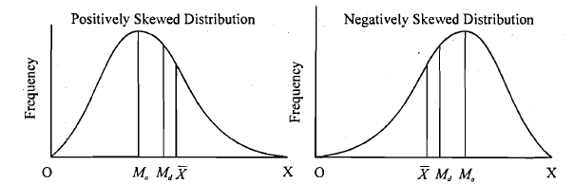
Skewness > 0
The distribution is asymmetrical and points in the positive direction.
Example: Test scores of difficult examination where almost everyone did poorly on it
mode < median < mean

Slide 57
Skewness < 0
The distribution is asymmetrical and points in the negative direction.
Example: Test scores of difficult examination where almost everyone did well on it
mode > median > mean

Slide 58
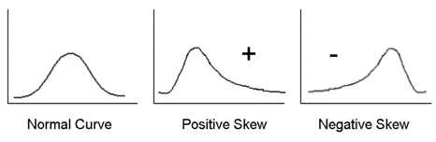
mode < median < mean
mode > median > mean

Slide 59
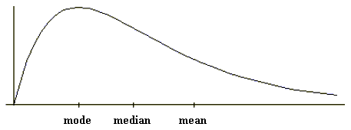
Right Skewed

Slide 60
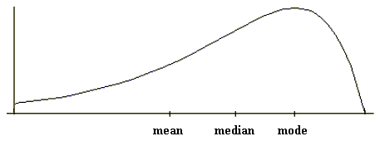
Left Skewed

Slide 61
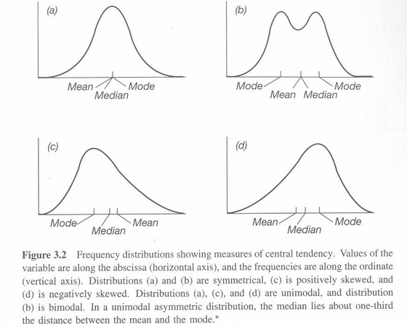

Slide 62
Kurtosis
Kurtosis is the statistic which describes the degree of peakedness or flatness of a probability distribution relative to the benchmark normal distribution.
In a similar way to the concept of skewness, kurtosis is a descriptor of the shape of a probability distribution
Formula to measure kurtosis for univariate data x₁, x₂, .., x_{N}:
Kurtosis =

Slide 63
Excess Kurtosis
Excess kurtosis is simply kurtosis − 3.
A normal distribution has kurtosis exactly 3 (excess kurtosis exactly 0). Any distribution with kurtosis ≈ 3 (excess ≈ 0) is called mesokurtic.
A distribution with kurtosis < 3 (excess kurtosis < 0) is called platykurtic. Compared to a normal distribution, its tails are shorter and thinner, and often its central peak is lower and broader.
A distribution with kurtosis > 3 (excess kurtosis > 0) is called leptokurtic. Compared to a normal distribution, its tails are longer and fatter, and often its central peak is higher and sharper.

Slide 64
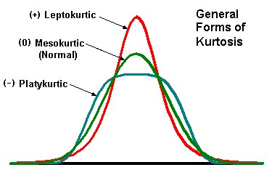

Slide 65
